Slide 1


COVID-19 vaccination progress around the world
Le meilleur outil de marketing pour votre entreprise.
Vaccination Progress Around The World
Marwa Drihem

Slide 2
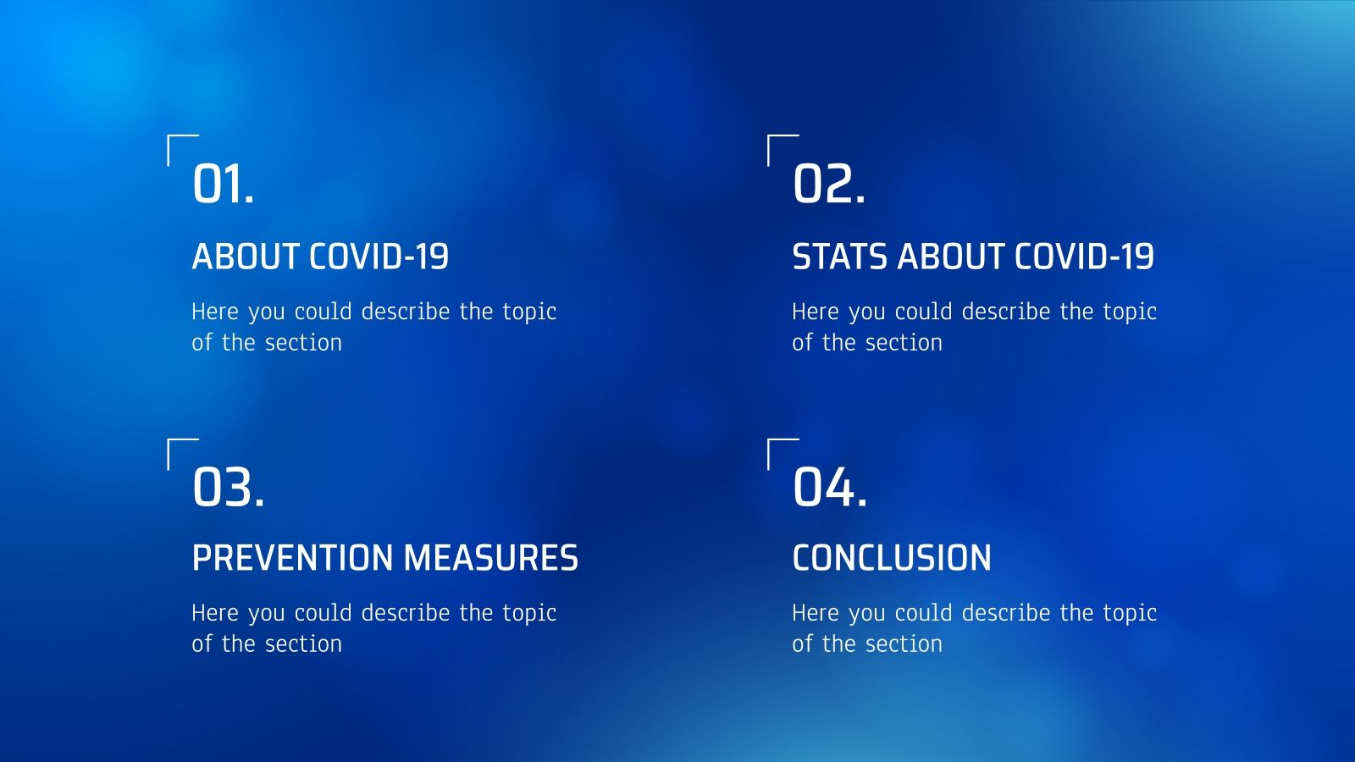
Introduction
Preparing for the battle
The battle
Conclusion

Slide 3

Introduction:
Introduction
At the moment, I guess almost everyone in this world has heard at least once about COVID-19. It has been nearly two years since the world recorded the first case of COVID-19. Fortunately, we have produced several types of vaccines against the pandemic. If you regurlarly update daily news, you must see and hear about COVID-19 statistics

Slide 4

The purpose of the project :
Humanity continues to fight the global epidemic, weapons in the form of vaccines against the virus have been developed in various countries, and mass vaccination of the entire population of the planet is underway.
The purpose of this work is to tell the story of how the struggle of the entire population of the planet with an insidious virus that has claimed millions of human lives all over the world is going on

Slide 5

Preparing for the battle

Slide 6
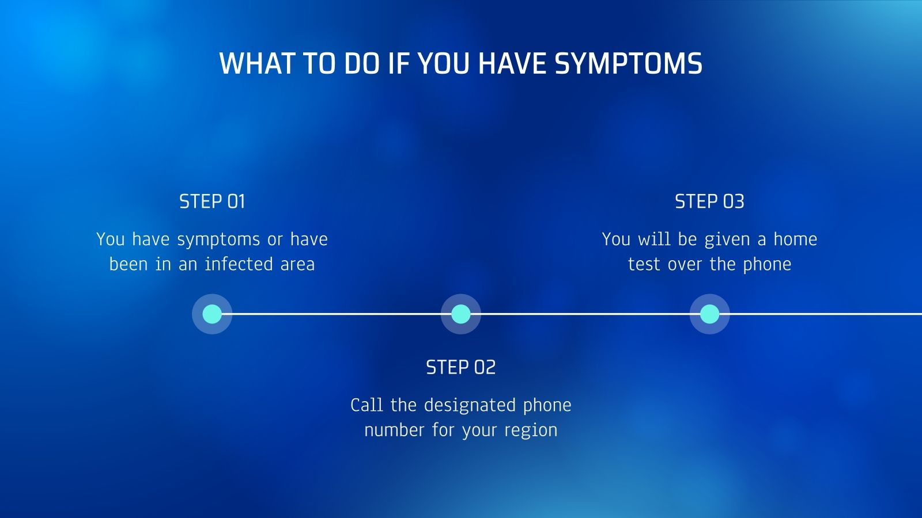
prepare the data for visualizations.
load the necessary libraries, select a color palette for further visualizations, prepare several functions
load the data, examine the types of variables, missing values, duplicates

Slide 7
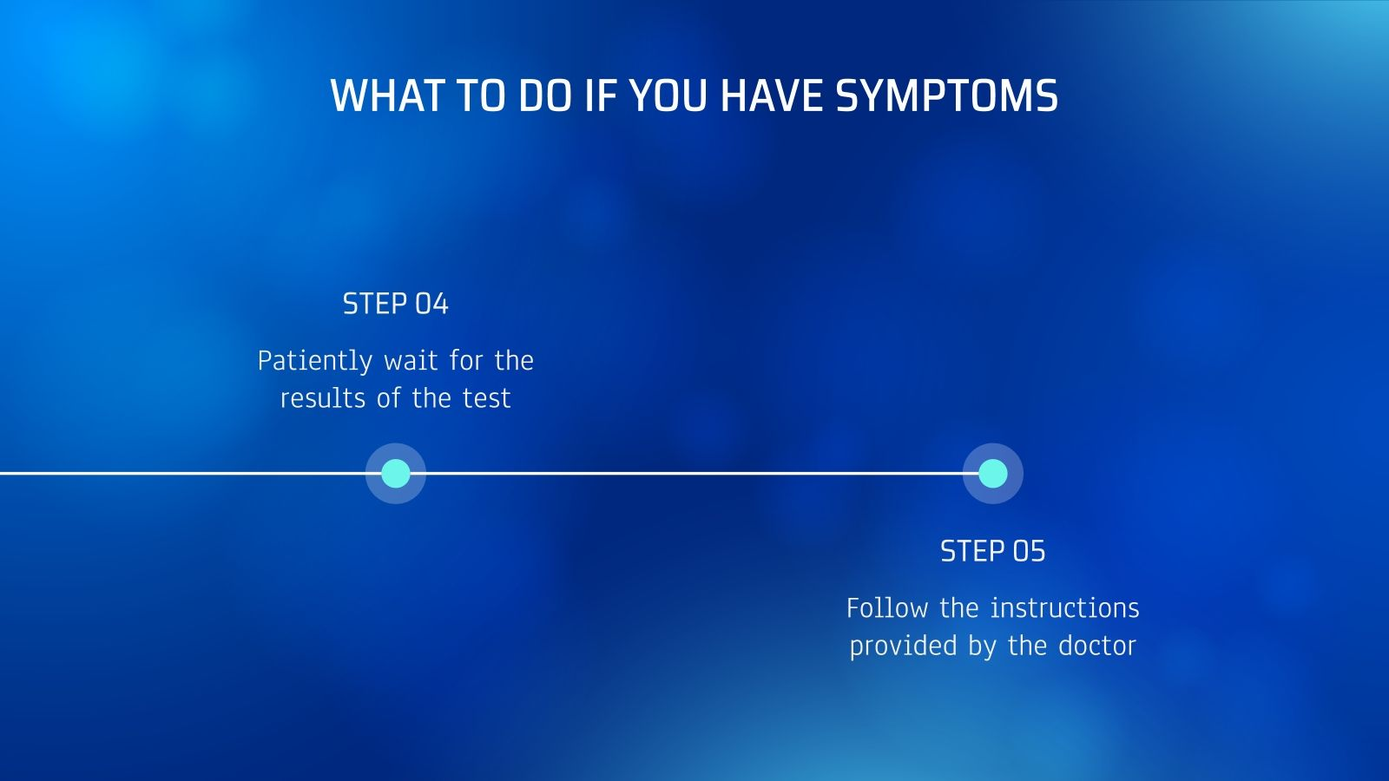
Choosing the right algorithm
Modeling

Slide 8
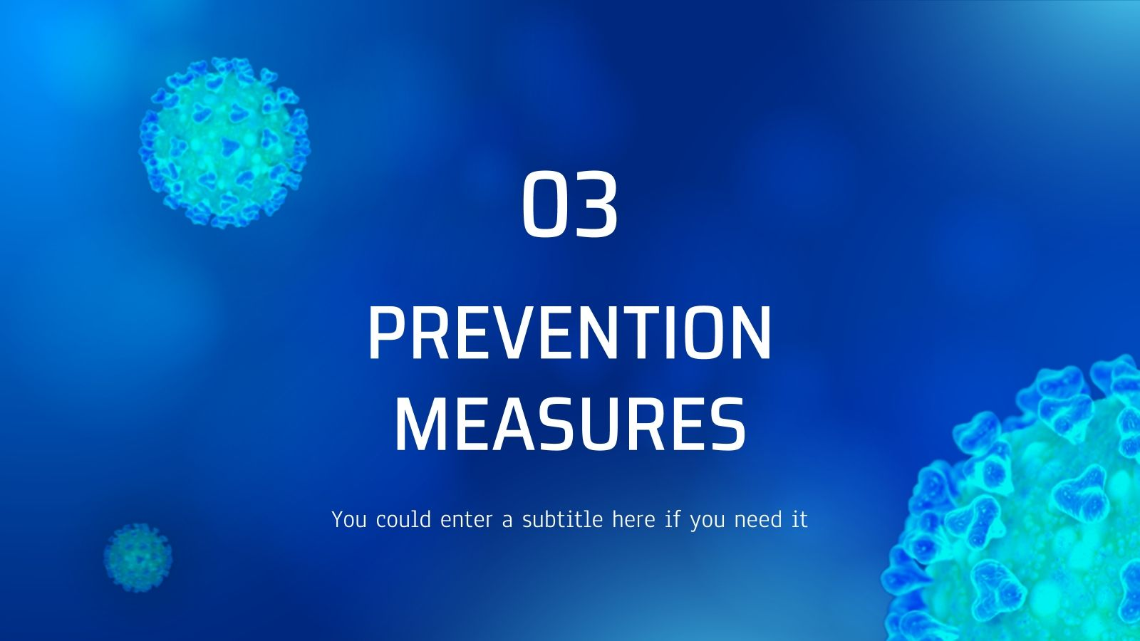
The battle

Slide 9
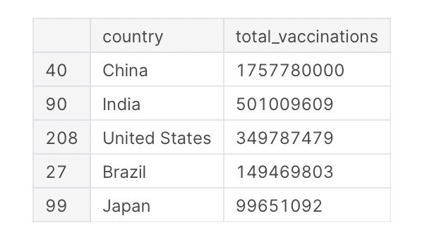
Some visualization :
Here, you can see that China, known as the first country that the COVID-19 pandemic occurred has the highest number of total vaccinations. Nearly 1.76 billions vaccine doses were used. It is reasonable because China has faced the pandemic for 2 years and they population is the highest in the world. The next 3 positions are for India, United States and Brazil. It is expected because these 3 countries have the highest number of cases.

Slide 10
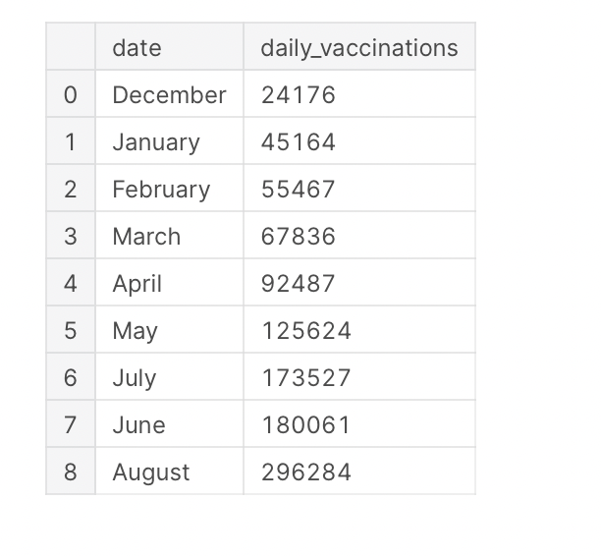
If you look closely, you will see that July came before June. Therefore, I would reindex these two months.

Slide 11
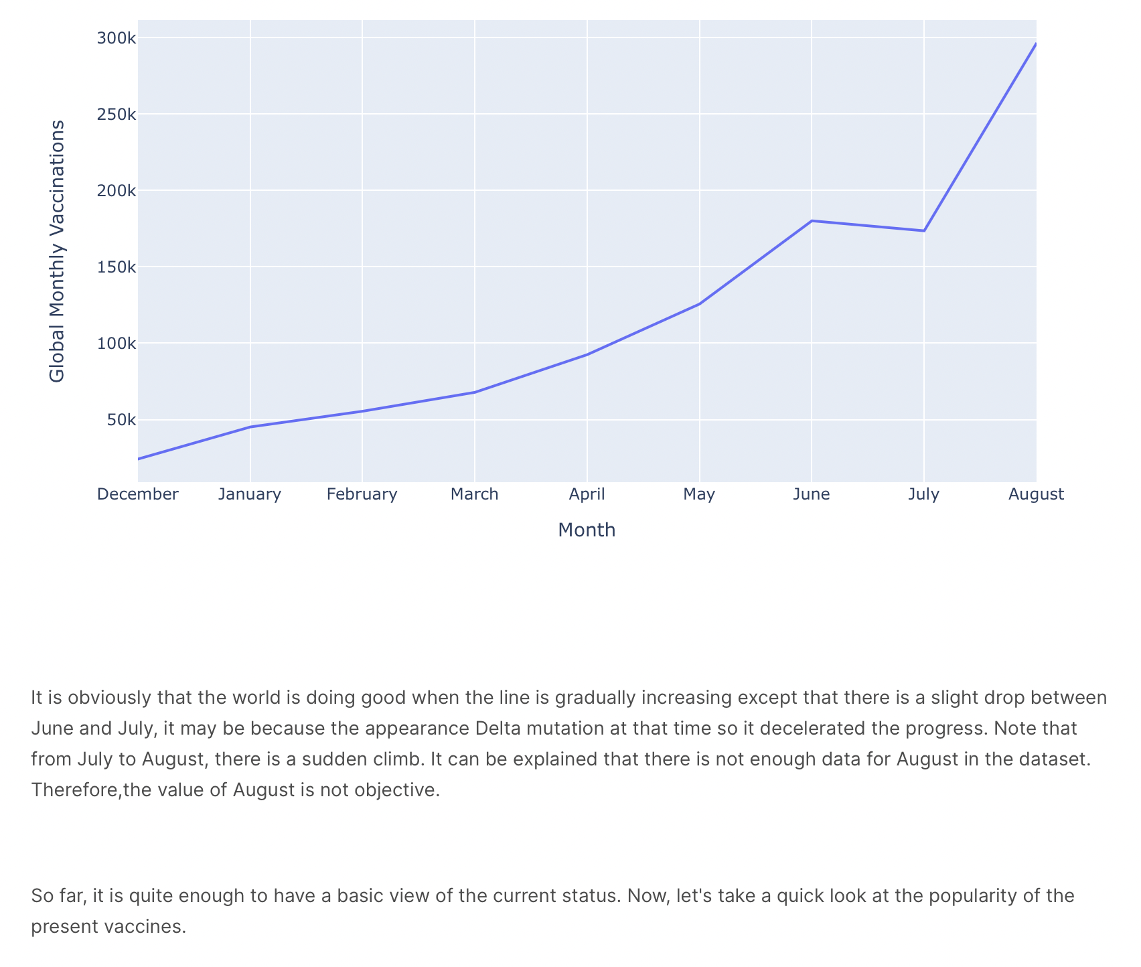

Slide 12
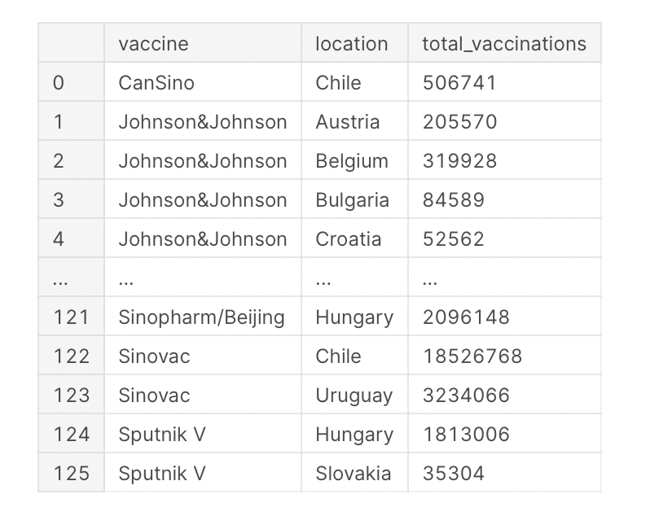

Slide 13
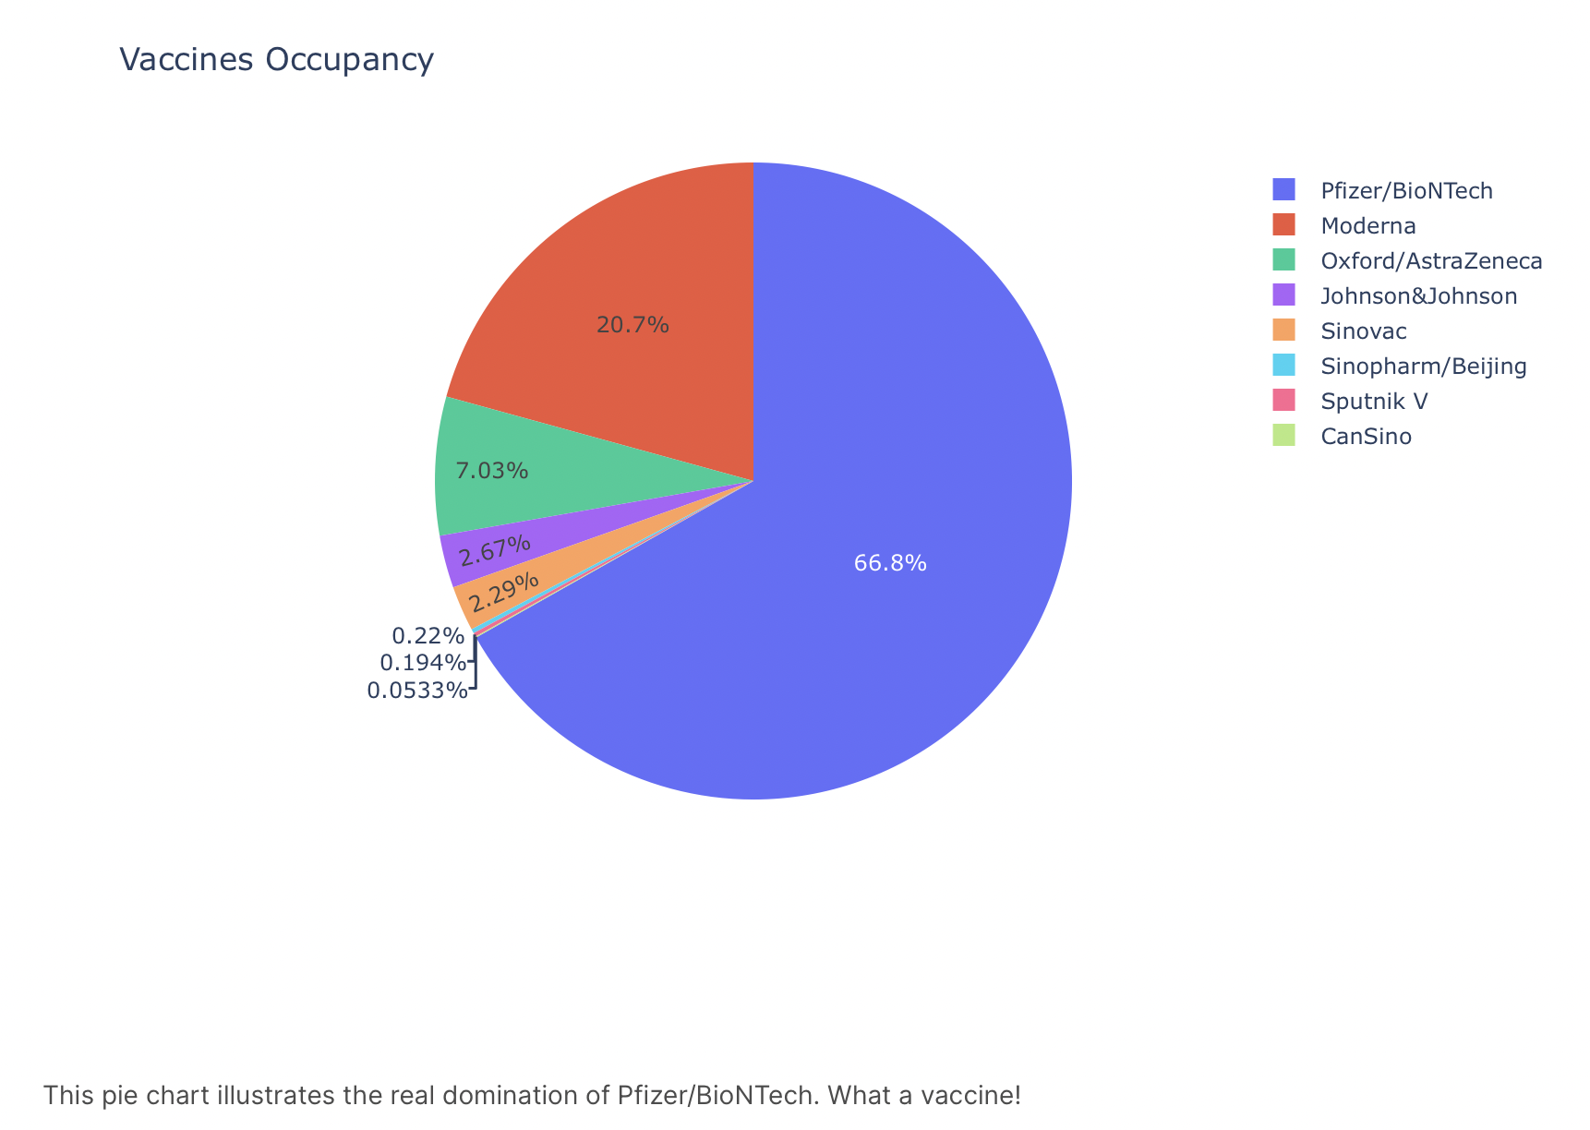

Slide 14
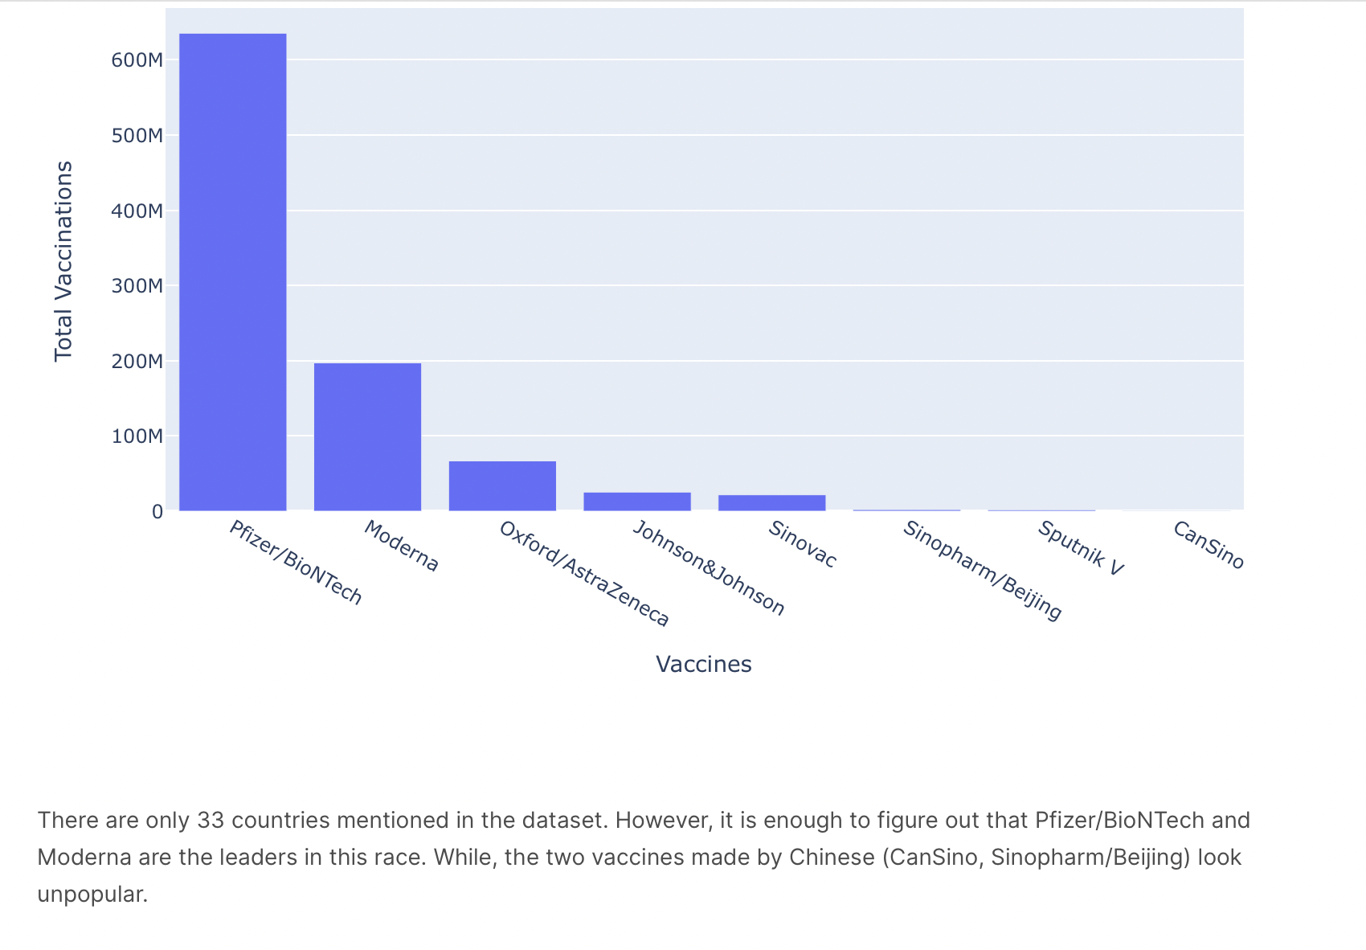

Slide 15
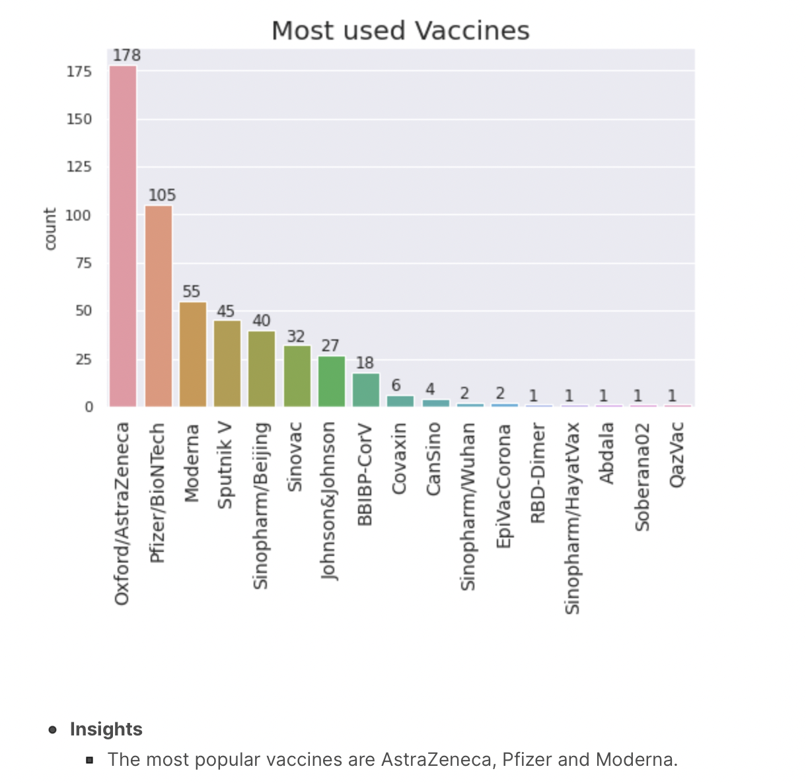

Slide 16
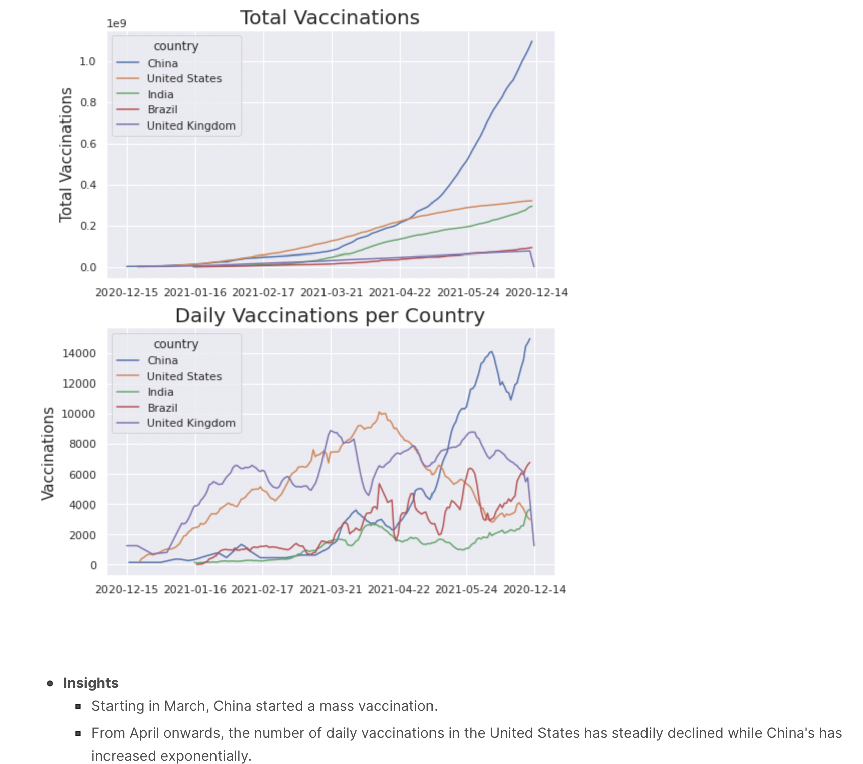

Slide 17

CONCLUSION:
Humanity today is actively confronting the global pandemic. Despite the active increase in infection in early 2020, mankind has managed to develop a weapon against the virus and reduce the number of cases and deaths around the world. The positive trend towards an improvement in the epidemiological situation in the world still persists, but the battle is not over yet. Humanity must be on the alert.

Slide 18



